Slide 1

The social meaning of TRAP-backing in Montréal English
Thomas Kettig & Katie drager
June 30, 2018
Sociolinguistics symposium 22
Tāmaki Auckland, Aotearoa New Zealand
Notes:
Today I'm going to be talking about TRAP-backing, or retraction, in Montréal English.

Slide 2
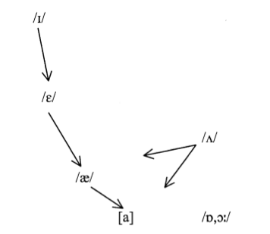

Canadian Shift
Also active in:
California (Eckert 2008; Kennedy & Grama 2012; Labov, Ash, & Boberg 2006)
Columbus, OH (Durian 2012)
Southern Illinois (Bigham 2010)
Hawai‘i (Drager et al. 2013)
Basically wherever there’s a cot-caught merger
Led by younger people and women

Slide 3
Social correlates of TRAP-backing
Link between TRAP-backing and personae/traits
Formality, Britishness (Podesva et al. 2012)
Valley Girl (D’Onofrio 2015a)
Business Professional (D’Onofrio 2015b)
In opposition to stigmatized regional features (D’Onofrio 2016)
Californianness, Valley Girlness, confidence (Villarreal 2018)
Notes:
Podesva et al. (2012)
Condoleezza Rice uses backer TRAP in formal, scripted speech compared to less formal conversational recordings
Prestige possibly associated with backer low vowels in British English
Could also be response to stigmatized TRAP raising (e.g. Northern Cities Shift)
D’Onofrio (2015a)
Eye tracking study
Listeners either told female speaker is from California or Valley Girl
Valley Girl caused listeners to expect TRAP-backing
D’Onofrio (2015b)
Vowel categorization task
When told woman is Business Professional or Valley Girl, categorization skewed toward accepting more backed tokens as TRAP
Like Dan & Mary Kohn
To what degree are the associations shared across regions? To what extent are they locally specific?

Slide 4
Current research question
What meanings are associated with TRAP-backing in Montréal?
Notes:
Most of the research has been done in California
Uses matched-guise technique with Montreal anglophone listeners, talkers from areas with TRAP-backing

Slide 5
Participant sample – Montréal
39 F, 13 M
Ages 18-35, mean = 23.4
All had lived in Montreal since childhood (at least 17 years)
English as first or home language
Mostly undergrad and graduate students

Slide 6
Methodology: Stimuli
2 M, 2F talkers recorded from HI, CA, MTL
2 x 2 x 3 regions = 12 talkers total
Retracted vs. unretracted guise for each /æ/ vowel resynthesized in Praat
12 fillers recorded (talkers ≠ HI, CA, MTL)
Presented without resynthesis
Notes:
These regions are all undergoing the shift and are all places we are interested in carrying out this experiment

Slide 7
Methodology: Stimuli
Unretracted Retracted
Male Female
F1 = 800
F2 = 1900
F1 = 800
F2 = 1700
F1 = 700
F2 = 1700
F1 = 700
F2 = 1500
Notes:
Just under 1 Bark difference

Slide 8
Methodology: Stimuli
Each listener responded to 36 sound files:
1M x 1F x 3 regions x 2 guises = 6 speakers in both guises = 12 stimuli
1M x 1F x 3 regions x 1 guises = 6 other speakers in one guise = 6 stimuli
18 fillers (6 repeats)
Repeated speakers’ two guises 10+ stimuli apart
Four different counterbalanced orders
Notes:
+ Roughly alternating sexes, with fillers always alternating with stimuli and region and guise roughly randomized
+ First sound file always a filler

Slide 9
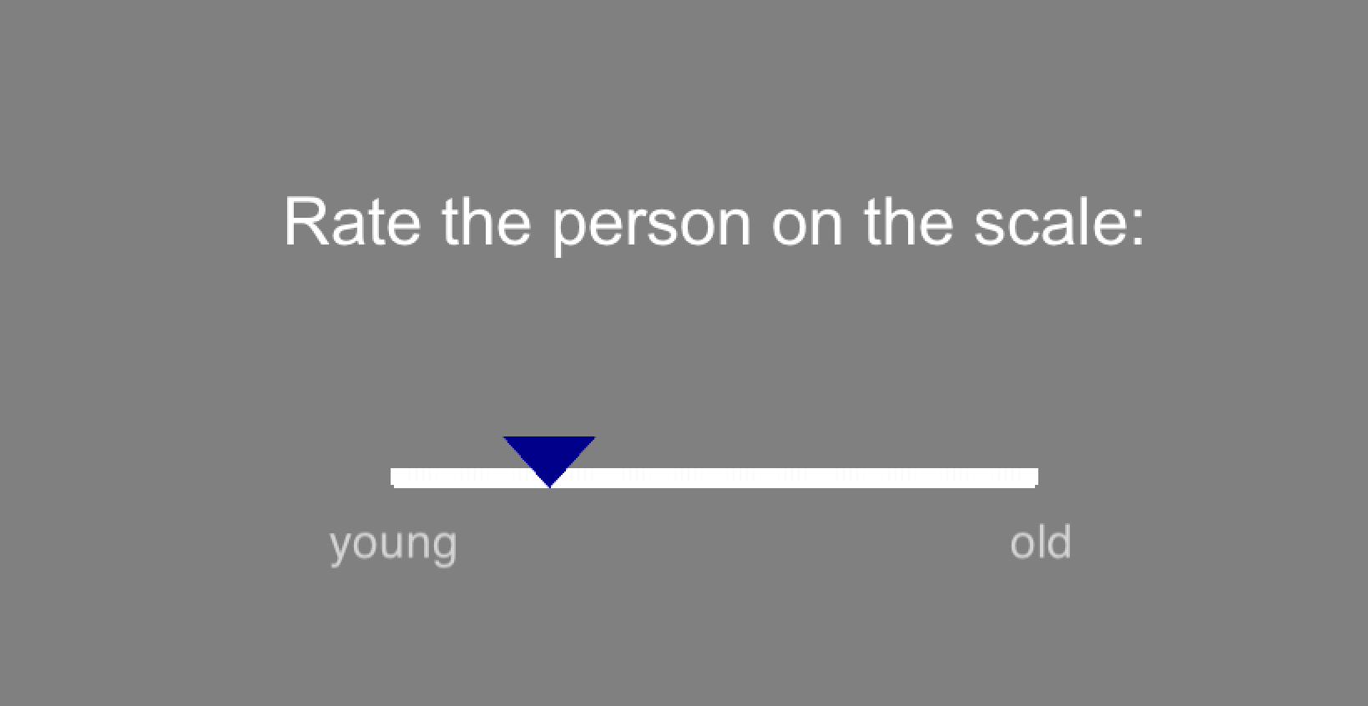
Methodology: Experiment
Stimulus “Without the map, we never could have found our way here”
Open-ended questions
Stimulus (repeated)
Continuous rating
Young – Old
Not confident – Confident
Not feminine – Feminine
Not masculine – Masculine
Unfriendly – Friendly
Not authoritative – Authoritative
Does not sound like me – Sounds like me
Notes:
Looking at age, friendliness, auth because of links with Valley Girl and Business Professional personae that have previously been researched – likely candidates for link with TRAP-backing

Slide 10
Specific questions
How are perceived age, friendliness, authoritativeness linked with TRAP-backing?
Does the gender of the listener matter?
Does the gender of the talker matter?

Slide 11
Age ~ Listener Gen + Talker Gen

Slide 12
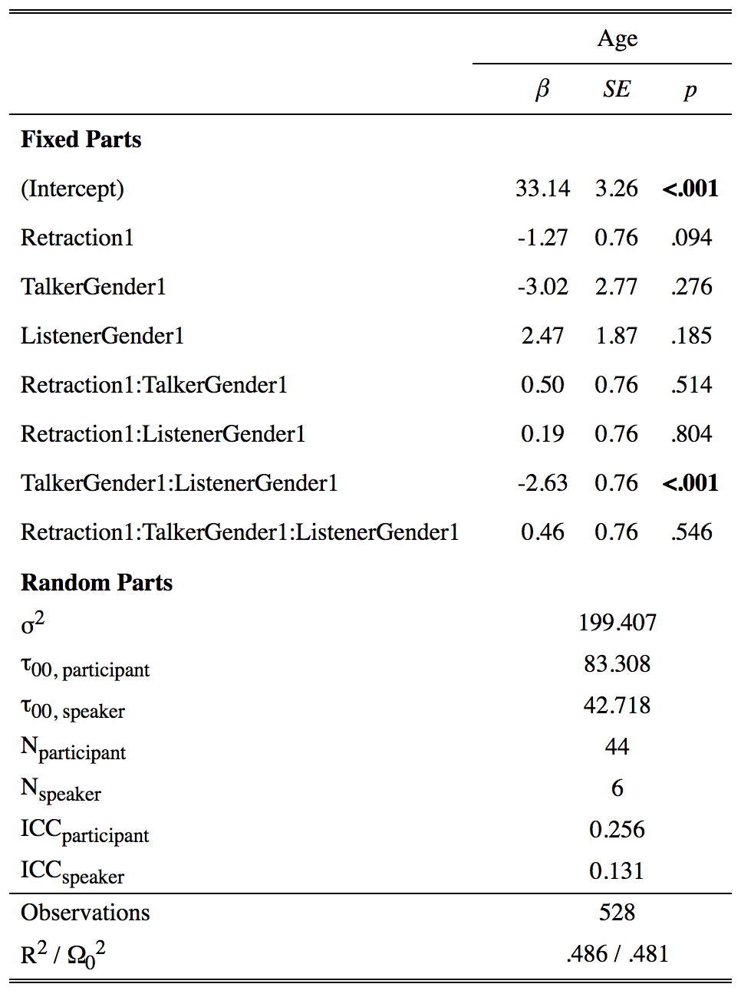
Age ~ Retraction * TalkerGender * ListenerGender + (1|participant) + (1|speaker)

Slide 13
Friendly ~ Listener Gen + Talker Gen

Slide 14
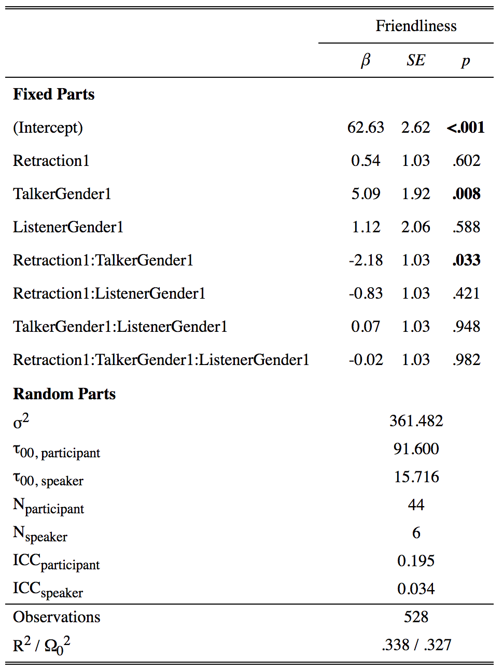
Friendliness ~ Retraction * TalkerGender * ListenerGender + (1|participant) + (1|speaker)

Slide 15
Authoritative ~ Listener Gen + Talker Gen

Slide 16
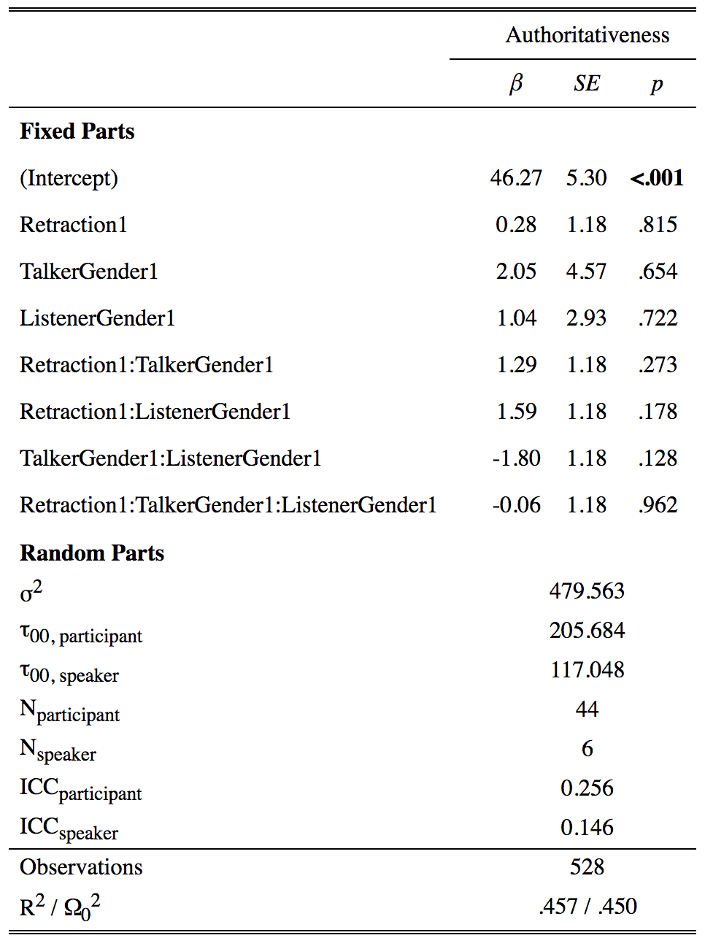
Authoritative ~ Retraction * TalkerGender * ListenerGender + (1|participant) + (1|speaker)

Slide 17
Results
Speakers
Female Male
Listeners
Male Female
Age R = UR
Friendliness R < UR *
Authoritative R ≥ UR
Age R < UR *
Friendliness R > UR *
Authoritative R = UR
Age R ≤ UR
Friendliness R = UR
Authoritative R = UR
Age R ≤ UR
Friendliness R > UR *
Authoritative R ≤ UR
Notes:
Female participants listening to female speakers:
Don’t use retraction as cue to age
Find retracted guise less friendly,
Trend toward hearing retracted as more authoritative
Female participants listening to male speakers
Use retraction as cue to age (younger = more retracted)
Find retracted guise more friendly, equally authoritative
Male participants listening to female speakers:
Trend toward hearing retracted as younger
No difference in friendliness, authoritativeness
Male participants listening to male speakers
Trend toward hearing retracted as younger, less authoritative
Retracted more friendly
So as we can see, we can’t necessarily make claims across the board about retracted/unretracted guise
Could be association between friendliness and auth, and could be linked to gender
M might be able to be friendly and authoritative, but F might not be

Slide 18
Results
To what extent are friendliness and authoritativeness correlated for these listeners? How is this linked with TRAP-retraction?
Notes:
Degree to which guise has effect on perceived auth depends on how friendly that speaker is also perceived to be
Need to have more nuanced understanding of what traits are being perceived - what are the gender dynamics?

Slide 19
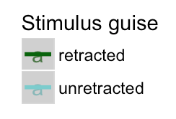
Results: Friendly ~ Authoritative
Notes:
Women listening to women + Men listening to men
Positive correlation between friendliness and authoritativeness in unretracted guise
Negative correlation between friendliness and authoritativeness in retracted guise
Women listening to men
Positive correlation between friendliness and authoritativeness in both guises
Men listening to women
Negative correlation between friendliness and authoritativeness in both guises

Slide 20
Results: Friendly ~ Authoritative
Friendliness and authoritativeness linked, but not straightforward
3-way interaction between listener gender, speaker gender, guise

Slide 21
General discussion
Listeners store phonetic traces of TRAP that are indexed with social information
Gender differences
Female listeners attend to stance (rather than age) cues in other women
Men attend to age
Experience or utilization?
Perception of social characteristics dependent on not just linguistic variant in signal, but all characteristics attributed to talker (Campbell-Kibler 2007, Levon 2014, Pharao et al. 2014)
Notes:
We interpret…
Maybe: shift more advanced for women, so for female listeners & speakers has taken on more meanings (different from men in terms of experience)
Or: women have learned it’s an unreliable cue for age because it also indexes other stances (different from men in terms of utilization of cues)

Slide 22
Future directions:
Qualitative analysis
Running same study in Hawaiʻi (ongoing), possibly California
Recruiting more male listeners in Montréal
Notes:
How widespread? Regional vs. supra-regional patterns

Slide 23
Mahalo + Kia ora!
Bilinski Educational Foundation for funding
McGill University Department of Linguistics
Prof. Michael Wagner – Prosody Lab
Listeners in Montréal
Talkers in Montréal and Hawaiʻi
Questions?
tkettig@hawaii.edu
kdrager@hawaii.edu

Slide 24
References
Bigham 2010
Campbell-Kibler 2007
D’Onofrio 2015a
D’Onofrio 2015b
D’Onofrio 2016
Drager, Kirtley, Grama & Simpson 2013
Durian 2012
Eckert 2008
Kennedy & Grama 2012
Labov, Ash & Boberg 2006
Levon 2014
Pharao et al. 2014
Podesva et al. 2012
Villarreal 2018

Slide 25
Age_response ~ retraction * speaker_gender * participant_gender + (1|participant) + (1|speaker)
Notes:
What these show is the equivalent of looking at the output of a mixed effects model, but instead of p-values, we have posterior distributions. Within these distributions, the colored sections indicate 95% credible intervals. The farther the distribution is from the 0 line, the more likely the result is to be an observed meaningful difference relative to the reference level. Here, we’ve contrast coded the data so that instead of having a single reference level, we can interpret more generally how meaningful the differences are for each fixed effect and their interactions. We see that there is a high probability of meaningful difference in our observation that there is an interaction between speaker gender and participant gender.

Slide 26
Friendly_response ~ retraction * speaker_gender * participant_gender + (1|participant) + (1|speaker)
Notes:
Here, there is a high likelihood of meaningful difference in observing the interaction of guise and speaker gender.

Slide 27
Authoritative_response ~ retraction * speaker_gender * participant_gender + (1|participant) + (1|speaker)
Notes:
Here, none of our observations reach 95% confidence, but it’s a close call for the interaction of speaker and participant gender.

Slide 28
Age_response ~ retraction * speaker_gender * participant_gender + (1|participant) + (1|speaker)
Notes:
What these show is the equivalent of looking at the output of a mixed effects model, but instead of p-values, we have posterior distributions. Within these distributions, the colored sections indicate 95% credible intervals. The farther the distribution is from the 0 line, the more likely the result is to be an observed meaningful difference relative to the reference level. Here, our reference level is retracted guise, female speaker, and female listener. We see that there is a high probability of meaningful difference in our observation that women listening to men think the unretracted guise sounds older than listening to women in the retracted guise; men listening to men think the retracted guise sounds younger, but not women listening to women.
Baseline/intercept: retracted + F speaker + F listener
unretracted + Fsp + Flist
retracted + Msp + Flist
unretracted + Msp + Flist – women listening to men think unretracted guise is older
unretracted + Fsp + Mlist
retracted + Msp + Mlist – men listening to men think retracted is younger (compared to retracted FspFlist)
unretracted + Msp + Mlist

Slide 29
Friendly_response ~ retraction * speaker_gender * participant_gender + (1|participant) + (1|speaker)
Notes:
Here, the most meaningful differences are that women find women’s unretracted guise more friendly than their retracted guise, and women find men’s unretracted guise less friendly than womens’ retracted guise.
Baseline/intercept: retracted + F speaker + F listener
unretracted + Fsp + Flist – women find women’s unretracted more frinedly
retracted + Msp + Flist
unretracted + Msp + Flist – women find men’s unretracted less friendly
unretracted + Fsp + Mlist
retracted + Msp + Mlist
unretracted + Msp + Mlist

Slide 30
Authoritative_response ~ retraction * speaker_gender * participant_gender + (1|participant) + (1|speaker)
Notes:
Here, the most meaningful differences observed are that women find women’s unretracted guise less authoritative than their retracted guise, women find men’s unretracted guise more authoritative than women’s retracted guise, and men find men’s retracted guise less authoritative than women find women’s retracted guise.
Baseline/intercept: retracted + F speaker + F listener
unretracted + Fsp + Flist – women find women’s unretracted less authoritative
retracted + Msp + Flist
unretracted + Msp + Flist – women find men’s unretracted more authoritative
unretracted + Fsp + Mlist
retracted + Msp + Mlist – men find men’s retracted guise less authoritative than women’s retracted guise
unretracted + Msp + Mlist

Slide 31
Future work: Qualitative questions
Notes:
Figure out good coding system for qualitative open-ended questions
Do qualitative results reflect quantitative? Do they tell a different story?
Can we identify other salient features associated with retracted guises?

Slide 32
Age ~ region

Slide 33
Age ~ ppt_gender + speaker_gender

Slide 34
Friendly ~ ppt_gender + spkr_gender

Slide 35
Friendly ~ region

Slide 36
Authoritative ~ spkr_gndr + ppt_gndr

Slide 37
Authoritative ~ region

Slide 38
Authoritative ~ region + spkr_gender

Slide 39
Age ~ Authoritative, F listener / F speaker

Slide 40
Age ~ Authoritative, F listener / M speaker

Slide 41
Age ~ Authoritative, M listener / F speaker

Slide 42
Age ~ Authoritative, M listener / M speaker

